Slide 1
OOP IN JAVA
Instructor:

Slide 2
Table of contents
Principles of OOP
Encapsulation
Inheritance

Slide 3
Learning Approach
Strongly suggested for a better learning and understanding of this course:
Noting down the key concepts in the class
Analyze all the examples / code snippets provided
Study and understand the self study topics
Completion and submission of all the assignments, on time
Completion of the self review questions in the lab guide
Study and understand all the artifacts
Completion of the project on time inclusive of individual and group activities
Notes:
The following are strongly suggested for a better learning and understanding of this course:
Noting down the key concepts in the class
Analyze all the examples / code snippets provided
Study and understand the self study topics
Completion and submission of all the assignments, on time
Completion of the self review questions in the lab guide
Study and understand all the artifacts including the reference materials / e-learning / supplementary materials specified
Completion of the project (if application for this course) on time inclusive of individual and group activities
Taking part in the self assessment activities
Participation in the doubt clearing Sections

Slide 4
Principles of OOP
Section 1

Slide 5
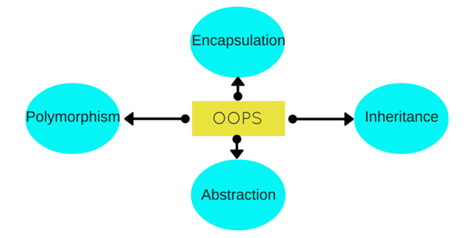
Principles of OOP
Object - Oriented Programming system (OOPs) is a programming paradigm based on the concept of “objects” that contain data and methods.
The primary purpose of object-oriented programming is to increase the flexibility and maintainability of programs.
Java is an object oriented language because it provides the features to implement an object oriented model.
These features includes Abstraction, Encapsulation, Inheritance and Polymorphism.

Slide 6
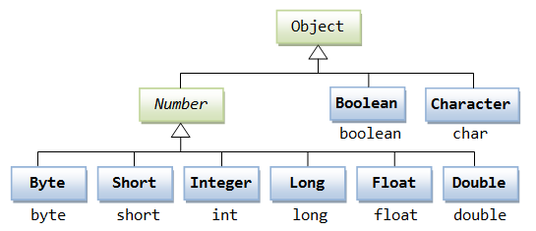
Inheritance
When one object acquires all the properties and behaviors of a parent object, it is known as inheritance. It provides code reusability.
Inheritance provides the idea of reusability of code and each subclass defines only those features that are unique to it, the rest of the features can be inherited from the parent class.
Inheritance is a process of defining a new class based on an existing class by extending its common data members and methods.
Inheritance allows us to reuse of code, it improves reusability in your java application.
The parent class is called the base class or super class. The child class that extends the base class is called the derived class or sub class or child class.

Slide 7
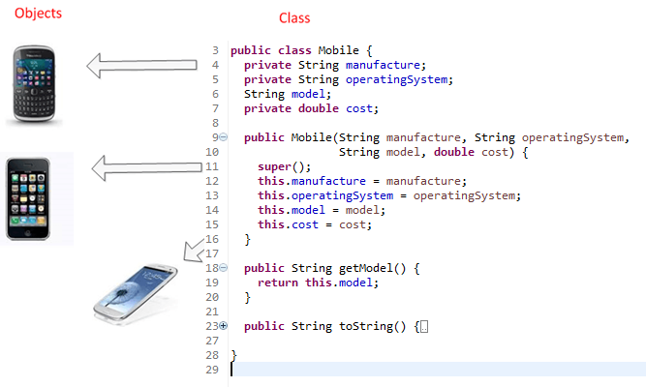
Inheritance
You can look into the following example for inheritance concept.
Mobile class:

Slide 8
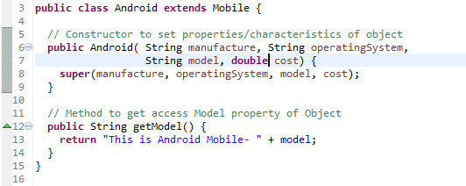
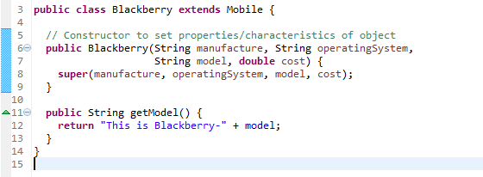
Inheritance
The Mobile class extended by other specific class like Android and Blackberry.
Android class:
Blackberry class

Slide 9
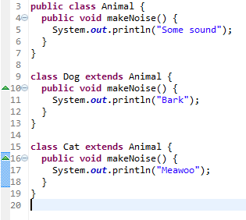
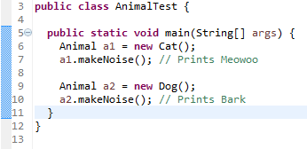
Polymorphism
If one task is performed by different ways, it is known as polymorphism.
Use method overloading and method overriding to achieve polymorphism.

Slide 10
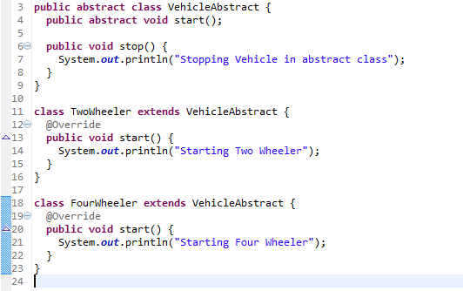
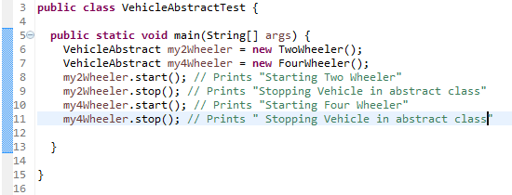
Abstraction
Hiding internal details and showing functionality is known as abstraction.
Use abstract class and interface to achieve abstraction.

Slide 11
Encapsulation
Encapsulation means putting together all the variables (instance variables) and the methods into a single unit called Class.
It also means hiding data and methods within an Object.
A programmer can access and use the methods and data contained in the black box but cannot change them.
Use access modifier: private, protected, default.

Slide 12
Encapsulation
Section 2

Slide 13
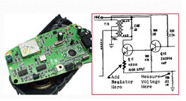
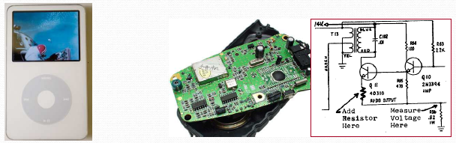
Encapsulation Overview
Encapsulation: Hiding implementation details from clients
Is the technique of making the fields in a class private
Providing access to the fields via public methods.
Prevents the code and data being randomly accessed by other code defined outside the class.
The ability to modify our implemented code without breaking the code of others who use our code.
Notes:
* Có thể cập nhật code đã cài đặt mà ko ảnh hưởng đến những đoạn mã khác mà đang sử dụng đến những đoạn mã bị cập nhật.

Slide 14
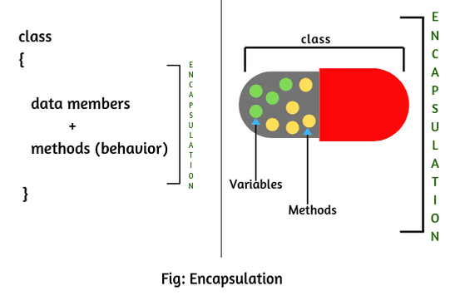
Encapsulation example in Java
Two steps to implement encapsulation feature:
Make the instance variables private so that they cannot be accessed directly from outside the class. You can only set and get values of these variables through the methods of the class.
Have getter and setter methods in the class to set and get the values of the fields.

Slide 15
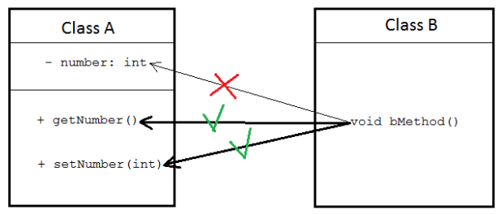
Getter and setter method
Getter and setter are two conventional methods that are used for retrieving and updating value of a variable.

Slide 16
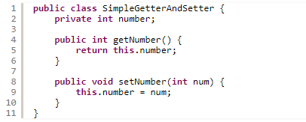

Getter and setter method
The following code is an example of simple class with a private variable and a couple of getter/setter methods:
“number” is private, code from outside this class cannot access the variable directly:
Instead, the outside code have to invoke the getter, getNumber() and the setter, setNumber() in order to read or update the variable, for example:

Slide 17

Why getter and setter?
By using getter and setter, the programmer can control how to variables are accessed and updated in a correct manner.
Example:
That ensures the value of number is always set between 10 and 100.
Suppose the variable number can be updated directly, the caller can set any arbitrary value to it:

Slide 18


Naming convention for getter and setter
The naming scheme of setter and getter should follow Java bean naming convention as follows:
getXXX() and setXXX()
where XXX is name of the variable.
For example with the following variable name:
If the variable is of type boolean, then the getter’s name can be either isXXX() or getXXX(), but the former naming is preferred.

Slide 19
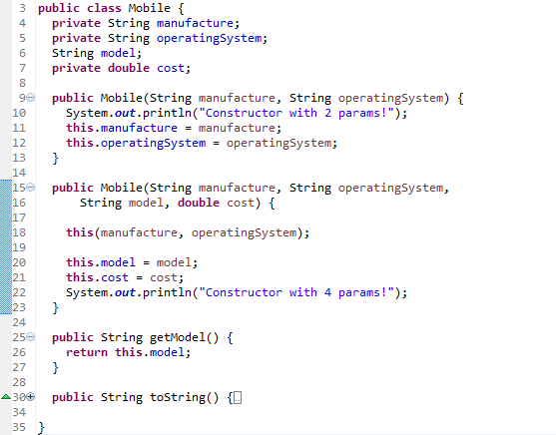
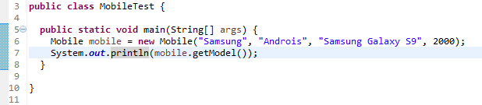
this keyword
“this” keyword in java can be used inside the method or constructor of Class.
It (this) works as a reference to the current Object, whose Method or constructor is being invoked.
this keyword with a field and constructor:
Output:
Constructor with 2 params!
Constructor with 4 params!
Samsung Galaxy S9

Slide 20
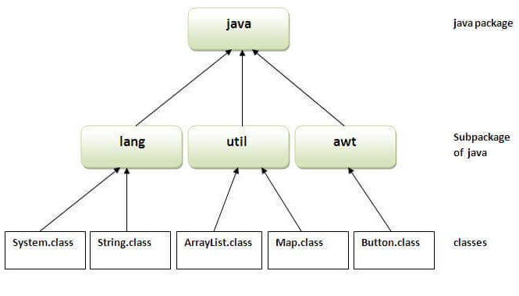
Java Package
A java package is a group of similar types of classes, interfaces and sub-packages.
Package in java can be categorized in two form: built-in package and user-defined package.
There are many built-in packages such as java, lang, awt, javax, swing, net, io, util, sql etc.
We will have the detailed learning of creating and using user-defined packages.
Advantage of Java Package:
Java package is used to categorize the classes and interfaces so that they can be easily maintained.
Java package provides access protection.
Java package removes naming collision.
There are three ways to access the
package from outside the package:
import package.*;
import package.classname;
fully qualified name.
Notes:
Java package removes naming collision: xung đột đặt tên

Slide 21
Access Modifiers
There are two types of modifiers in Java: access modifiers and non-access modifiers.
The access modifiers in Java specifies the accessibility or scope of a field, method, constructor, or class.
There are four types of Java access modifiers:
Private: The access level of a private modifier is only within the class. It cannot be accessed from outside the class.
Default: The access level of a default modifier is only within the package. It cannot be accessed from outside the package. If you do not specify any access level, it will be the default.
Protected: The access level of a protected modifier is within the package and outside the package through child class. If you do not make the child class, it cannot be accessed from outside the package.
Public: The access level of a public modifier is everywhere. It can be accessed from within the class, outside the class, within the package and outside the package.
Non-access modifiers: static, abstract, synchronized, native, volatile, transient, etc.

Slide 22
Access Modifiers
Access Modifier | Within class | Within package | Outside package by subclass only | Outside package
Private | Y | N | N | N
Default | Y | Y | N | N
Protected | Y | Y | Y | N
Public | Y | Y | Y | Y

Slide 23
Inheritance
Section 3

Slide 24
Inheritance Overview (1/2)
Inheritance allows you to define a new class by specifying only the ways in which it differs from an existing class.
Inheritance promotes software reusability (tính tái sử dụng)
Create new class from existing class
Absorb existing class’s data and behaviors
Enhance with new capabilities
Inheritance represents the IS-A relationship which is also known as a parent-child relationship.

Slide 25
Terms used in Inheritance
Syntax:
Terms:
Class: A class is a group of objects which have common properties.
Sub Class/Child Class: Subclass is a class which inherits the other class. It is also called a derived class, extended class, or child class.
Super Class/Parent Class: Superclass is the class from where a subclass inherits the features. It is also called a base class or a parent class.
Reusability: As the name specifies, reusability is a mechanism which facilitates you to reuse the fields and methods of the existing class when you create a new class. You can use the same fields and methods already defined in the previous class.
class SubclassName extends SuperclassName {
//methods and fields
}

Slide 26
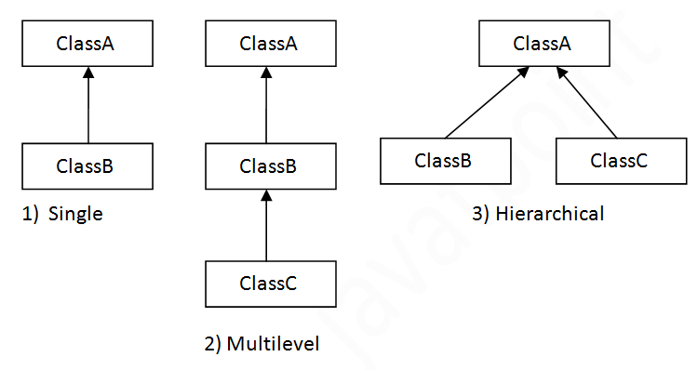
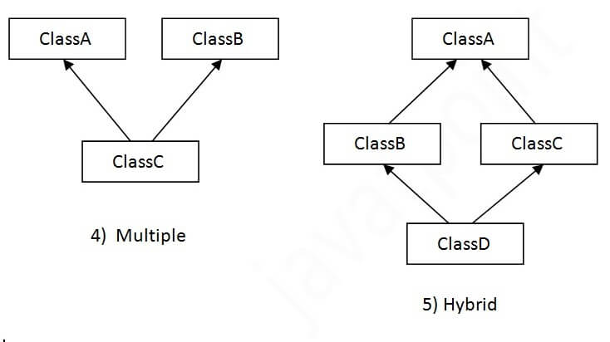
Types of inheritance in java
Three types of inheritance in java: single, multilevel and hierarchical.
Note: Multiple inheritance is not supported in Java through class.

Slide 27
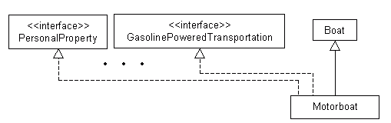
Inheritance
Two kinds:
implementation: the code that defines methods.
interface: the method prototypes only.
You can't extend more than one class!
the derived class can't have more than one base class.
You can do multiple inheritance with interface inheritance.

Slide 28
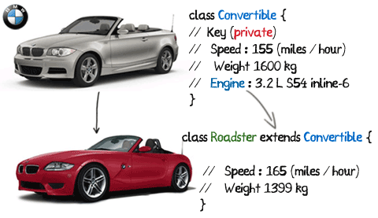
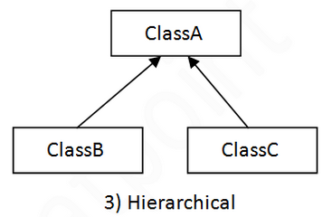
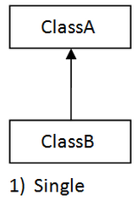
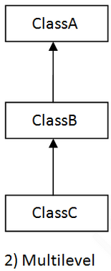
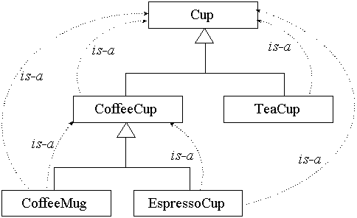
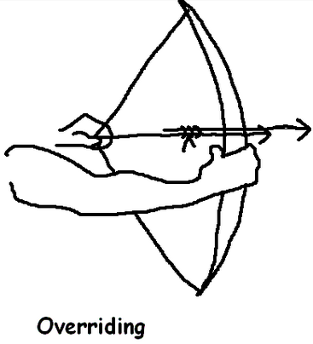
Inheritance Vocabulary (1/3)
Inheritance Vocabulary:
Superclass/Subclass
OOP Hierarchy
Overriding
"isa“ - an instance of a subclass is-a
instance of the superclass.
Superclass
Subclass
Notes:
General vs. Specific
The "super" and "sub" terms can be a little counterintuitive:
Superclass has fewer properties, is less constrained, is more general (confusingly, the word "super" can suggests a class with more properties) .
Subclass has more properties, is more constrained, is more specific.

Slide 29
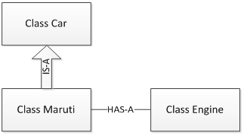
Inheritance Vocabulary (2/3)
“IS-A”
“IS-A” relationship – this thing is a type of that thing
Inheritance
Subclass object treated as superclass object
“HAS-A”
“HAS-A” relationship - class A HAS-A B if code in class A has a reference to an instance of class B.
Aggregation
Object contains one or more objects of other classes as members
Example: Maruti is a Car
Car properties/behaviors also Maruti properties/behaviors
Example: Maruti has a Engine

Slide 30

Inheritance Vocabulary (3/3)
Class hierarchy
Multiple inheritance:
Inherits from multiple superclasses
Java does not support multiple inheritance in classes
Direct superclass^{[kế thừa trực tiếp]}:
Inherited explicitly (one level up hierarchy)
Single inheritance
Inherits from one superclass
Indirect (multilevel) superclass
Inherited two or more levels up hierarchy
Notes:
Java does not support multiple inheritance in classes, but interface is OK.

Slide 31
Inheritance Example
Shape is superclass
Shape
Color
Circle and Rectangle has Color property
getColor()
setColor()
draw()
getPerimeter()
getArea()
Circle
Rectangle
Circle isa Shape, but Shape is not a Circle.
Method draw(), getPerimeter(), getArea() in Circle overriding method draw() , getPerimeter(), getArea() in Shape.
If we add/remove property to/from Shape, then it’s affected to Circle and Rectangle.
Center
Radius
Length
Width
getCenter()
setCenter()
getRadius()
setRadius()
draw()
getPerimeter()
getArea()
getLenght()
setLenght()
getWidth()
setWidth()
draw()
getPerimeter()
getArea()
Circle and Rectangle are subclasses
Notes:
Circle and Rectangle inherit Shape, so Circle and Rectangle has Color property, which is inherited from Shape.
Shape is superclass.
Circle and Rectangle are subclasses.
Circle isa Shape, but Shape is not a Circle.
Method draw() in Circle overriding method draw() in Shape.
If we add/remove property to/from Shape, then it’s affected to Circle and Rectangle.

Slide 32
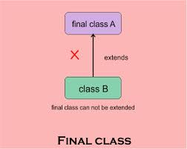
Inheritance
Final class:
You can declare an class is final - this prevents the class from being subclassed.
Of course, an abstract class cannot be a final class.

Slide 33
Superclasses and Subclasses Contructor and Finalizers
Instantiating subclass object
Chain of constructor calls
Subclass constructor invokes superclass constructor
Implicitly or explicitly
Base of inheritance hierarchy
Last constructor called in chain is Object’s constructor
Original subclass constructor’s body finishes executing last.

Slide 34
Superclasses and Subclasses Contructor and Finalizers
Examples:
class Building {
Building() {
System.out.print("b ");
}
Building(String name) {
this();
System.out.print("bn " + name);
}
}
public class House extends Building {
House() {
System.out.print("h ");
}
House(String name) {
this();
System.out.print("hn " + name);
}
public static void main(String[] args) {
new House("x ");
}
}

Slide 35
Superclasses and Subclasses Contructor and Finalizers
Garbage collecting subclass object
Chain of finalize method calls
Reverse order of constructor chain
Finalizer of subclass called first
Finalizer of next superclass up hierarchy next
Continue up hierarchy until final superreached
After final superclass (Object) finalizer, object removed from memory

Slide 36
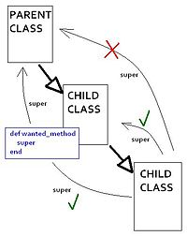
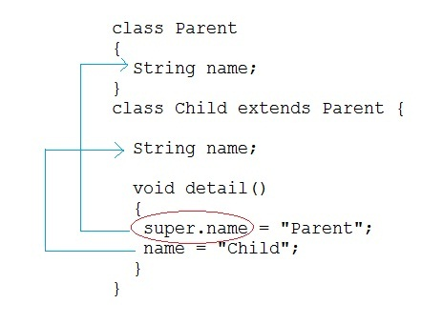
super keyword
Can use super keyword to access all (non-private) superclass methods.
even those replaced with new versions in the derived class.
Can use super() to call base class constructor.
Subclass methods are not superclass methods

Slide 37
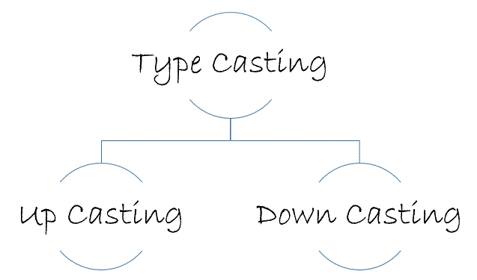
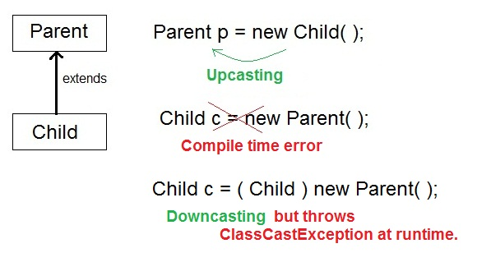
Casting Objects
Java permits^{[cho phép]} an object of a subclass type to be treated as an object of any superclass type. This is called upcasting.
Upcasting and downcasting are NOT like casting primitives from one to other.
Upcasting is done automatically.
Downcasting must be manually done by the programmer

Slide 38
Casting Objects Examples
class Animal {
public void eat() {
System.out.println("Generic Animal Eating Generically");
}
}
class Horse extends Animal {
public void eat() {
System.out.println("Horse eating hay, oats, " + "and horse treats");
}
public void buck() {
System.out.println("This is buck");
}
}
public class TestAnimals {
public static void main(String[] args) {
Animal a = new Animal();
Animal b = new Horse(); // Animal ref, but a Horse object – upcasting
Horse h = new Horse();
a.eat(); // Runs what?
b.eat(); // Runs what?
// What is the result?
Animal c = new Horse();
c1.buck();
}
}
➔ Cannot invoke subclass-only (Horse) methods on subclass object through superclass (Animal) reference

Slide 39
protected Members in Inheritance (1/2)
protected access
Intermediate level of protection between public and private;
protected members accessible to:
superclass members
subclass members
Class members in the same package
Subclass access superclass member
Keyword super and a dot (.)
There is no super.super….

Slide 40
protected Members in Inheritance (2/2)
Using protected instance variables
Advantages
subclasses can modify values directly
Slight increase in performance
Avoid set/get function call overhead
Disadvantages
No validity checking
subclass can assign illegal value
Implementation dependent
subclass methods more likely dependent on superclass implementation
superclass implementation changes may result in subclass modifications

Slide 41
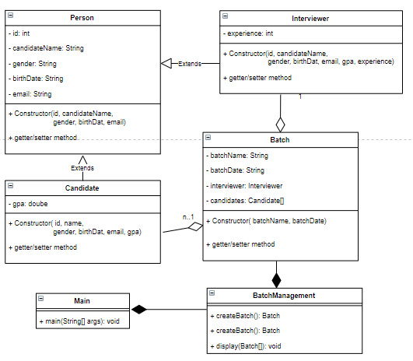

Practice time
In class diagrams, as shown in following Figure. Let’s implement it using Java:

Slide 42
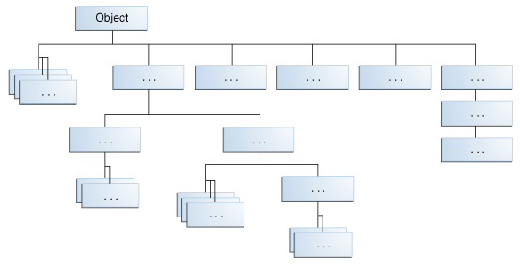
The class Object
Granddaddy of all Java classes.
All methods defined in the class Object are available in every class.
Any object can be cast as an Object.

Slide 43
Summary
Inheritance is a mechanism that allows one class to reuse the implementation provided by another.
A class always extends exactly one superclass.
If a class does not explicitly extend another, it implicitly extends the class Object.
A superclass method or field can be accessed using a super. keyword.
Subclass objects can not access superclass’s private data unless they change into protected access level.
If a constructor does not explicitly invoke another (this() or super()) constructor, it implicitly invokes the superclass's no-args constructor.
Encapsulation:
Hiding implementation details from clients.

Slide 44

Thank you
44

